Slide 1
Evenly Spaced Streamlines
By, Hitisha Damani
Parth Sanghani

Slide 2
Problem Definition
Streamlines can depict the flow of the vectors more efficiently.
Overlapping Streamlines cause a problem.
Method needed which works efficiently for both sparse and dense flow fields.
Proposed method by Bruno Jobard and Wilfrid Lefer.

Slide 3
Methodology
Algorithm:-
Compute an initial streamline and put it into the queue
Let this initial streamline be the current streamline
Repeat for all points on x axis:
Repeat for all points on y axis:
Select a candidate seedpoint at d = dsep apart from the current streamline
Until the candidate is valid or there is no more available candidate
If a valid candidate has been selected Then
Compute a new streamline and put it into the queue
Else If there is no more available streamline in the queue Then
Finished := True
Else
Let the next streamline in the queue be the current streamline
EndIf
EndIf

Slide 4
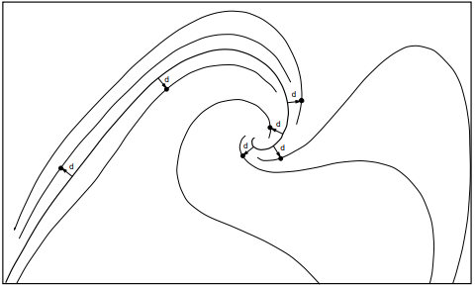
Methodology
Implementing the project for five vector fields.

Slide 5
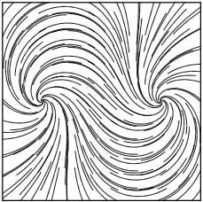
Output
Streamlines with seed-points on the regular grid

Slide 6
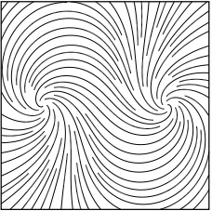
Output
Streamlines with the seed point calculated using this method

Slide 7
Future Work
Reduce the ‘Blind Spots’ in visualization of a given vector field
Implement other integration method like RK Integration
Extend the project by implementing LIC or E-LIC
Adding other visualization techniques like glyph mapping

Slide 8
Responsibilities
Getting seed-points and StreamLine integration | Parth Sanghani
UI Design and implementing termination condition | Hitisha Damani

Slide 9
Thank You

